Slide 1

CHAPTER 8 Virtual Memory: Hardware and Control Structions
Instructor: Wuman LUO
luowuman@ipm.edu.mo
Office: A213
14:30-17:30 Tuesday & Wednesday

Slide 2

Two Characteristics – 1
Memory references are translated by the CPU dynamically
Logical/physical address translation is done at each memory access (for data and program)
OS can put the pages of a process anywhere in RAM, and it can move the pages without interfering the process
Notes:
Two characteristics of paging and segmentation are the keys to this breakthrough:
1. All memory references within a process are logical addresses that are dynamically translated into physical addresses at run time. This means that a process may be swapped in and out of main memory such that it occupies different regions of main memory at different times during the course of execution.
2. A process may be broken up into a number of pieces (pages or segments) and these pieces need not be contiguously located in main memory during execution. The combination of dynamic run-time address translation and the use of a page or segment table permits this.

Slide 3
Two Characteristics – 2
Each page is mapped to a frame independently
A process may be broken up into pieces that do NOT need to be located contiguously in RAM
The OS may partially swap a process. E.g., page 0 and page 2 are in RAM, while page 1 is swapped out to hard disk.
Notes:
Two characteristics of paging and segmentation are the keys to this breakthrough:
1. All memory references within a process are logical addresses that are dynamically translated into physical addresses at run time. This means that a process may be swapped in and out of main memory such that it occupies different regions of main memory at different times during the course of execution.
2. A process may be broken up into a number of pieces (pages or segments) and these pieces need not be contiguously located in main memory during execution. The combination of dynamic run-time address translation and the use of a page or segment table permits this.

Slide 4
Address translated dynamically…
Physical address
Suppose “a=0” is compiled to the assembly “mov [00000100], 0”. At the moment that the CPU executes this instruction, the logical address 0x00000100 will be translated to the physical address 0x00026100 using the page table.
00026
100
00022
00023
Logical address
00000
100
00024
00025
00000
a
a
00026
00001
00027
00002
00028
Addressing space
of process C
00029
00000
00026
RAM
00001
00027
00002
00028
Page table of process C

Slide 5
Address translated dynamically…
Physical address
After swapping, the process image moves to a different location in RAM. When the CPU executes the instruction “mov [00000100], 0” (a=0) again, logical address 00000100 will be translated to new location automatically (physical address 00022100).
00022
100
a
00022
00023
Logical address
00000
100
00024
00025
00000
a
00026
00001
00027
00002
00028
Addressing space
of process C
00029
00000
00022
RAM
00001
00023
00002
00024
Page table of process C

Slide 6
Each page is mapped independently…
Physical address
The three pages 00000, 00001 and 00002 (the first 12k in the addressing space) appear to be contiguous to process C. But, in fact, they are mapped to separate frames in RAM.
00023
100
00022
a
00023
Logical address
00000
100
00024
00025
00000
a
00026
00001
b
00027
00002
b
00028
Addressing space
of process C
00029
00000
00023
RAM
00001
00028
00002
00026
Page table of process C

Slide 7
Each page is mapped independently…
Physical address
And the OS can swap part of the addressing space to the hard disk. Some pages are swapped out, while the other pages are still present in the RAM.
00023
100
00022
a
00023
Logical address
00000
100
00024
00025
00000
a
00026
00001
00027
00002
00028
Addressing space
of process C
00029
00000
00023
RAM
00001
swap
00002
00026
b
Page table of process C

Slide 8
What we’ll learn...
Virtual memory
What, advantages, how, page fault handling, efficiency
Hardware support: page table, page table point, TLB
OS support
Esp. Page replacement algorithm
Requirements of memory management revisited

Slide 9
Virtual Memory
“Simulate more RAM using hard disk space”
The program/data used by a process DO NOT have to be present in the RAM all the time. Pages not currently used are swapped out to disk.
When needed, these pages are swapped in, back to some frames in RAM. This operation is invisible to the process.

Slide 10
Advantages of Virtual Memory
More processes can be kept in main memory
only some pieces of each process are loaded
better utilization of the CPU
It is possible for a process to be larger than all the main memory
easier life for programmer

Slide 11
How virtual memory works, 1
In this example, the first three pages of process C are mapped to separate frames. The three variables, x,y,z, are stored in the three pages.
RAM
00000
00001
00002
00003
x
00004
Addressing space
of process C
00005
00000
00004
00000
x
00006
00001
00007
00001
y
y
00007
00002
00008
00002
z
z
00008
Page table of process C
00003
00009

Slide 12
How virtual memory works, 2
After some time, the OS may find that there is not enough memory, and decide to swap out frame 00008. (how the OS decides which frame to swap out? Refer to replacement algorithm in second half of this chapter).
RAM
00000
00001
00002
00003
x
00004
Addressing space
of process C
00005
00000
00004
00000
x
00006
00001
00007
00001
y
y
00007
00002
swap
00002
z
00008
Page table of process C
00003
00009
z

Slide 13
How virtual memory works, 3
This does not interfere the execution of the process until it accesses any byte in page 00002. E.g. when the process reads the value of the variable z, the CPU notices that the data is not present in RAM and generates a trap called page fault. Control will be transferred to the OS.
RAM
x = 1; y = x*2; x = z + 1;
00000
00001
➔
00002
00003
x
00004
Page fault when CPU tries to read z
Addressing space
of process C
00005
00000
00004
00000
x
00006
00001
00007
00001
y
y
00007
00002
swap
00002
z
00008
Page table of process C
00003
00009
z

Slide 14
How virtual memory works, 4
This does not interfere the execution of the process until it accesses any byte in page 00002. E.g. when the process reads the value of the variable z, the CPU notices that the data is not present in RAM and generates a trap called page fault. Control will be transferred to the OS.
How? We will learn later in this chapter that the CPU detects page fault by checking the P bit in the page table entry of the page in address translation.

Slide 15
How virtual memory works, 5
… The CPU generates a page fault trap, and control is transferred to the OS. The OS
block the process (other processes can run)
find the page in the swap file in hard disk
find an unused frame in RAM
issue a read request to the hard disk
RAM
x = 1; y = x*2; x = z + 1;
00000
00001
zz➔
00002
00003
x
00004
Page fault when CPU tries to read z
Addressing space
of process C
00005
00000
00004
00000
x
00006
00001
00007
00001
y
y
00007
00002
swap
00002
z
00008
Page table of process C
00003
z
00009
z

Slide 16
How virtual memory works, 6
… When the page loading is completed,
an I/O interrupt occurs
the OS updates the page table of process
that caused the page fault
The OS wakes up the process
RAM
x = 1; y = x*2; x = z + 1;
00000
00001
➔
00002
00003
x
00004
Addressing space
of process C
00005
00000
00004
00000
x
00006
00001
00007
00001
y
y
00007
00002
00009
00002
z
00008
Page table of process C
00003
z
00009
z

Slide 17
Page Fault Handling – Steps
A page fault occurs when a reference memory address is not present in RAM
The CPU issues a trap, and the OS handles it:
Block the process (while other processes can run)
Find the page in the swap file in hard disk
Find an unused frame in RAM
Issue a read request to the hard disk
When page loading is completed (disk I/O finishes)
An interrupt occurs
OS updates the page table of the blocked process that causes the page fault
OS wakes up the process

Slide 18
Process state changes in Page Fault Handling
Running ⇨ blocked ⇨ ready
The process does not know that a page fault occurs (similar to an ordinary process switching)
While the page is being read into memory, other processes can use the CPU
Page swap in
(page loaded event occurs)
Page fault
(wait for page loaded)

Slide 19
Efficiency of Virtual Memory
Hard disk I/O is much slower than RAM
If the OS swaps out a page just before using it, it has to get that page almost immediately. This is known as thrashing.
Thrashing is a state in which the system spends most of its time swapping pieces rather than executing instructions.
To avoid thrashing, the OS tries to guess (based on recent history) which pieces are least likely to be used in the near future.
In other words, can we just keep a few pages in RAM for a process WITHOUT thrashing?

Slide 20
Principle of Locality
Program and data references within a process tend to cluster
Over a long period of time, the clusters in use change
Over a short period of time, the processor is primarily working with fixed clusters of memory references.
Notes:
This reasoning is based on belief in the principle of locality, which was introduced in Chapter 1 (see especially Appendix 1A). To summarize, the principle of locality states that program and data references within a process tend to cluster. Hence, the assumption that only a few pieces of a process will be needed over a short period of time is valid. Also, it should be possible to make intelligent guesses about which pieces of a process will be needed in the near future, which avoids thrashing.

Slide 21
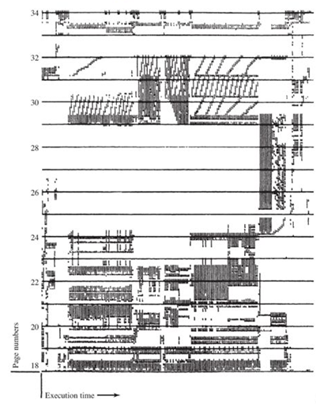
Locality in a Memory-Reference Pattern
Note that during the lifetime of the process, references are confined to a subset of pages.
Notes:
Give a brief description of this figure to the students – the detail probably not be clear in the presentation, but it is the overall clustering that is important and interesting
The figure is a rather famous diagram that dramatically illustrates the principle of locality [HATF72].
Note that during the lifetime of the process, references are confined to a subset of pages.

Slide 22
Principle of Locality
Temporal locality – tendency to access data that are accessed recently
Pieces used frequently will likely be used in the near future. The OS can make intelligent guess of which page to swap out. (Page replacement algorithm)
Spatial locality – tendency to access data near data that are recently accessed
Only a few pages of a process are needed within a short period of time

Slide 23
Hardware Support to Virtual Memory
Detail structure of the page table
How the CPU detects page fault
How the CPU accesses the page table of the running process, the page table pointer register
How the TLB caches most recently used entries of the running process
P
M
00000
1
1
00002
00001
1
0
00000
00002
0
???
Page table
TLB
00001
00000
…...
…...
Page table ptr
0123A000
CPU

Slide 24
Page Table Entry -- PTE
00000
00004
Page table is an array of page table entries (PTE). Each PTE stores information about a page of the process.
1
1
00004
00001
00007
⇨
1
0
00007
00002
swap
0
???
PTE of page 00000
Frame number
1
1
00004
Other control bits... E.g. Use bit
Modify bit: is the page altered since last loaded into memory?
Present bit: is the page in main memory?

Slide 25
Page Table
Each process has its own page table
What about threads within this process?
Each page table entry contains
Frame number – where this page maps to
Present bit – the page is in RAM?
Modify bit – any byte modified in the page since last loaded?
Other control bits...

Slide 26
Present Bit
“Is the page in RAM?”
In address translation, the CPU first checks the Present bit of the page.
If P=1, the page is present, and address translation continues. The process continues without blocking.
If P=0, a page fault occurs, and the OS is invoked to handle this.
For detail, refer to “page fault handling” in the beginning of this chapter.

Slide 27
Modify Bit
“Any byte modified in the page since last loaded?”
Example usage: If no change has been made since last loaded into memory, the page content is the same as the copy in the swap file (hard disk). Therefore, when it is swapped out, the OS does not need to write the page to the swap file.
Other usage of the M bit is discussed in “page replacement algorithm” later in this chapter.

Slide 28
Page Table Pointer
Logical addr
The page table pointer is a register that holds the starting address of the page table of the running process.
Physical addr
page no.
frame no.
00001
ABC
00000
ABC
offset
offset
In address translation, CPU computes the address of the relevant PTE by adding the page number to the page table pointer.
Page table pointer
0123A000
Page table
What happens to page table pointer in process switching? In thread switching?
00000
1
1
00002
+
00001
1
0
00000
00002
0
???
P
M
Also read Fig 8.3
frame number

Slide 29
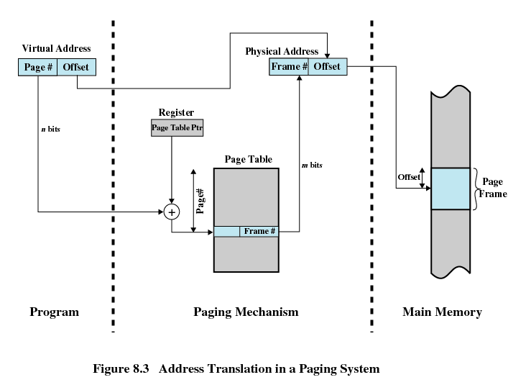
Address Translation in a Paging System

Slide 30
How CPU reads a PTE
CPU
RAM
Logical addr
x
Frame 0
00001
AAA
Frame 1
Page table ptr
Physical addr
0123A000
AAA
Frame 2
00000
1
0
00000
Page table
P
M
Read page table entry at
Addr: 0123A000+00001=0123A001
1
1
00002
1
0
00000
0
???
Frame 0123A
Read the data at physical address 00000AAA

Slide 31
Page Table Can Be Big...
The entire page table may take up too much memory
e.g. A process in Pentium can have at most 2^20 pages. Each page table entry takes 32 bits (4 bytes). So a page table can occupy up to 4MB!
Solutions:
Page table stored in virtual memory
Two-level page table

Slide 32
Two-level Page Table
RAM
Page table fragments of 1024 PTE
Page Directory
1024 PDE
The original big page table is divided into fragments of 1024 PTE. The size of each is 4096 bytes, which fit a frame. They are stored in separate frames or swapped out. The page directory keeps track of these 1024 page table fragments.
Notes:
The secret to the multlevel page table method is to avoid keeping all the page tables in memory all the time.

Slide 33
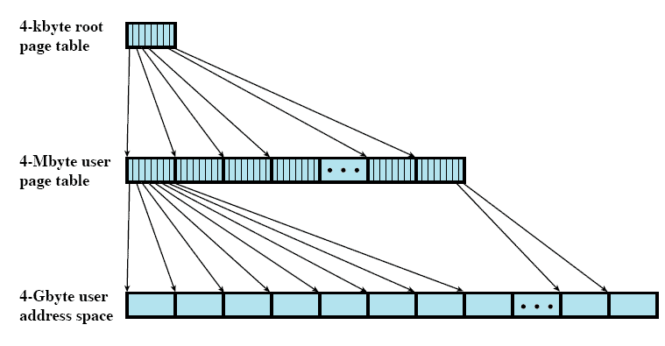
Two-Level Hierarchical Page Table

Slide 34
Two-level Page Table
Address of
page table
Each process has a page directory, which is always present and contains pointer to fragments of page table.
P
000
1
0A0A0
001
1
0B123
...
..
...
P
Frame number
7FF
0
???
000
1
10001
001
1
10003
1024 PTE
...
..
..
..
10 bit
10 bit
7FF
0
???
000
001
ABC
The first 10 bits in a logical address are used to index the page directory to find the address of the relevant page table. Then the next 10 bits are used to index the found page table to find the corresponding frame number.
12 bit offset
Logical address

Slide 35
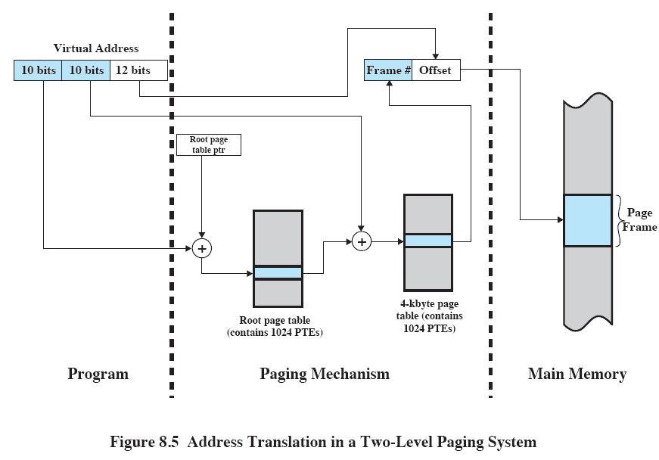
Address Translation for Hierarchical page table

Slide 36
Virtual Memory Access Can Be Very Slow...
Each virtual memory reference can cause two physical memory accesses
one to fetch the page table entry
one to fetch the data

Slide 37
Translation Lookaside Buffer
Translation Lookaside Buffer, TLB is an associative cache that contains page table entries most recently used
TLB is fast (cache inside the CPU)
TLB is small (16*4 entries in Pentium)
why such a small cache is enough?
TLB
00001
00000
…
00000
00002
…
…...
…...
…
E.g. page 00001 maps to frame 00000 (other info in PTE omitted…)
What happens to TLB in process switching? In thread switching?

Slide 38
How TLB Works – TLB hit
Physical address
Logical address
frame number
page number
offset
00000
ACE
00001
ACE
TLB
offset
00001
00000
00000
00002
First, the CPU tries to look up the TLB in parallel. If the page mapping is found (a TLB hit), the frame number in the TLB is used.
…...
…...
Page table
00002
00000
00001

Slide 39
How TLB Works – TLB Miss
Physical address
Logical address
frame number
page number
offset
00001
ACE
00002
ACE
TLB
offset
00001
00000
If the page mapping is not found (a TLB miss), the CPU looks up the PTE of the page in page table and form the physical address. This mapping is also inserted into the TLB.
00000
00002
…...
00002
…...
00001
Page table
00002
00000
00001

Slide 40
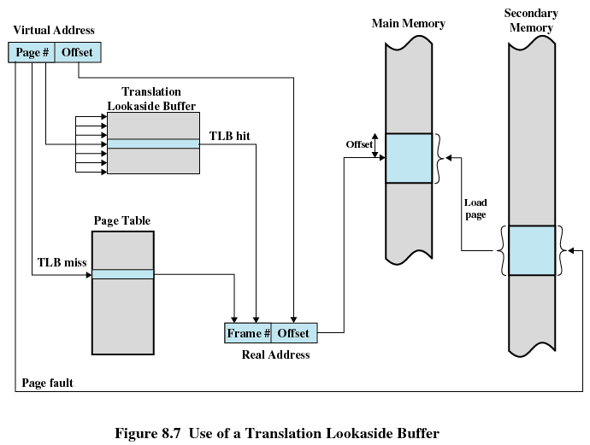
Use of a Translation Lookaside Buffer

Slide 41
How TLB works
Given a logical address, processor first checks the TLB
If the page table entry is found there (a hit)
The frame number is retrieved and the physical address is formed
No memory reference to the page table

Slide 42
How TLB Works
If the page table entry is NOT found (a miss)
CPU uses the page number to index the page table of the process to obtain the corresponding frame number
Page fault might occur and is handled by the OS
The TLB is updated to include the new page entry
The frame number is used to complete the physical address

Slide 43
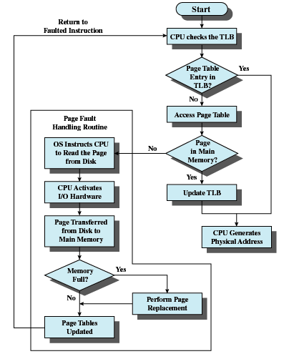
Operation of Paging and TLB

Slide 44
At each memory access ...
At each virtual memory access, the MMU (memory management unit) performs the following:
- Split the logical address into page number and offset
- Try to look up the TLB for the page number
- TLB hit: use the frame number cached to complete the physical address
- TLB miss: ...
1
- Add the page number to the page table pointer register to obtain the address of the relevant page table entry
Try to read the PTE
Add the mapping to TLB
- Check P bit
Present: use the frame number in PTE to complete physical address
Absent: page fault ...
2
3

Slide 45
At each memory access, cont.
...
- absent: page fault ...
3
Page fault handling:
The CPU issues an interrupt/trap, and the OS handles it:
- block the process (other processes can run)
- find the page in the swap file in hard disk
- find an unused frame in RAM (w/ page replacement algorithm)
- issue a read request to the hard disk
When the disk I/O finishes:
- an interrupt occurs
- OS updates the page table of the blocked, page fault process
- OS wakes up the process

Slide 46
Memory access at TLB hit (page present)
1
CPU
RAM
TLB
x
Frame 0
00001
00000
Logical addr
Frame 1
…...
…...
00001
ABC
Frame 2
Page table ptr
Physical addr
0123A000
00000
ABC
Page table
P
M
Read data at
Addr: 00000ABC
1
1
00002
1
0
00000
Frame 0123A
0
???

Slide 47
Memory access at TLB miss (page present)
2
CPU
RAM
TLB
Frame 0
00001
00000
Logical addr
Frame 1
00000
00002
…...
…...
00000
ABC
x
Frame 2
Page table ptr
Physical addr
0123A000
00002
ABC
Page table
Read page table entry at
Addr: 0123A000+00000=0123A000
P
M
1
1
00002
1
0
00000
Frame 0123A
Read data at
Addr: 00002ABC
0
???

Slide 48
Memory access at page fault (page not present)
3
CPU
RAM
TLB
Frame 0
00001
00000
00000
00002
Logical addr
Frame 1
…...
…...
00002
EEE
Frame 2
Page table ptr
Physical addr
0123A000
EEE
Page table
Read page table entry at
Addr: 0123A000+00002=0123A002
P
M
1
1
00002
1
0
00000
Frame 0123A
Page fault at page 00002.
CPU asks the OS for help
0
???

Slide 49
Page Size
Smaller page size means
Less amount of internal fragmentation
But … smaller page size also means
More pages required per process
More pages per process means larger page tables
Larger page tables means large portion of page tables in virtual memory
Secondary memory is designed to efficiently transfer large blocks of data so a large page size is better

Slide 50
Page Size
Small page size, large number of pages will be found in main memory
As time goes on during execution, the pages in memory will all contain portions of the process near recent references. Page faults low.
Increased page size causes pages to contain locations further from any recent reference. Page faults rise.

Slide 51
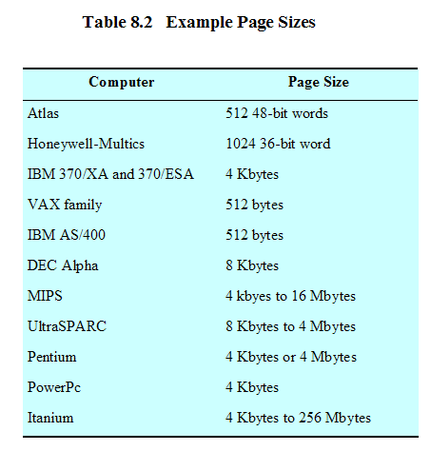
Example Page Sizes

Slide 52
Segmentation
May be unequal, dynamic size
Simplifies handling of growing data structures
Easier to sharing data among processes
Easier to protect data

Slide 53
Segment Table
Each entry contains the length of the segment, P bit, M bit, and the base address of the segment.
Segment table
P
M
length
base
0
1
0
40k
10101000
1
1
1
50k
20202000
2
1
1
20k
30303000

Slide 54
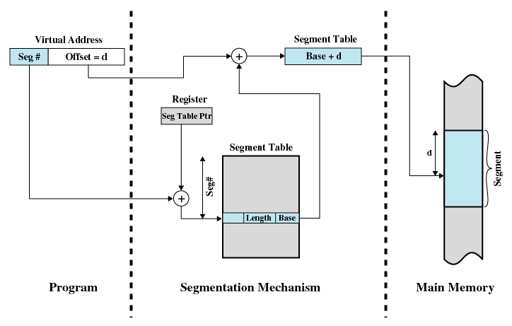
Address Translation in a Segmentation System

Slide 55
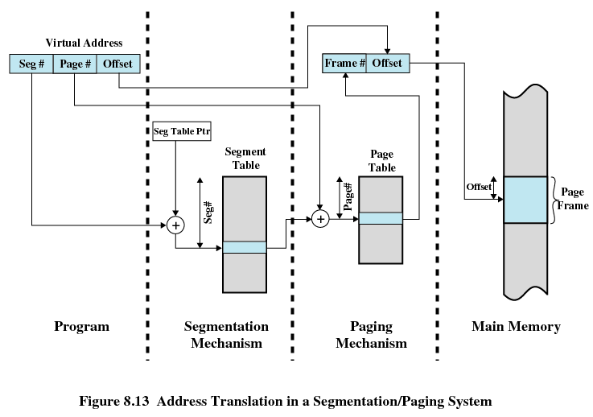
Combined Segmentation and Paging

Slide 56

Next Topic
Virtual Memory: Operating System Software
Read Ch. 8

